Slide 1
Introduction To Data management
Stock Market Analysis
Navin chandra
Registration No – 12001138
Programme and Section – KM007 Course Code – INT217

Slide 2
CONTENT
1 Introduction
2 Objectives/Scope of the Analysis
3 Source of dataset
4 ETL process
5 Analysis on dataset 1
• Introduction
• General Description
• Specific Requirements, functions and formulas
• Analysis results
Visualization Analysis on dataset 2
• Introduction
• General Description
• Specific Requirements, functions and formulas
• Analysis results
• Visualization
Analysis on dataset 3
• Introduction
• General Description
• Specific Requirements, functions and formulas
• Analysis results
• Visualization
Analysis on dataset 4
• Introduction
• General Description
• Specific Requirements, functions and formulas • Analysis results
• Visualization Analysis on dataset 5
• Introduction
• General Description
• Specific Requirements, functions and formulas • Analysis results
• Visualization
6 List of Analysis with results
7 References
8 Bibliography

Slide 3
Introduction
This project is on Stock market analysis project.
Data of this project is taken from the website called Kaglge.com we have downloaded the Nifty-50 data of 50 companies and have chosen the top 5 companies to do analysis . In this project we will analyse the stocks of few top companies from Nifty-50 using excel, pivot table, conditional formatting and using some formula and will also create the yearly stock chart of the companies using excel chart.
In stock market analysis project we can analyse the price, profit, up’s and down’s of the market that how the companies is preforming is in previous few years we, have taken data of companies from year 2000 to 2021 and do analysis.
We have also created the stock charts for the companies to see the performance of the companies on charts We have created a Dashboard for this project and also added links on the dashboard page through which we can navigate to any other page or objectives and also created a home page and objective page on objective there is information regarding the analysis we have done also by the links we can navigate to the analysis page

Slide 4
Objectives/Scope of the Analysis
1. In which year ITC had given huge LOSS
2. Total profit given by ONGC Till now
3. Create a Stock chart of TATAMOTORS and show its highest price till Now
4. create Yearly Stock Chart of HINDUNILIVR using UP&DOWN bars
5. In which year HDFC had its highest closing price

Slide 5

Source of dataset
https://www.kaggle.com/rohanrao/nifty50-stock-market-data

Slide 6
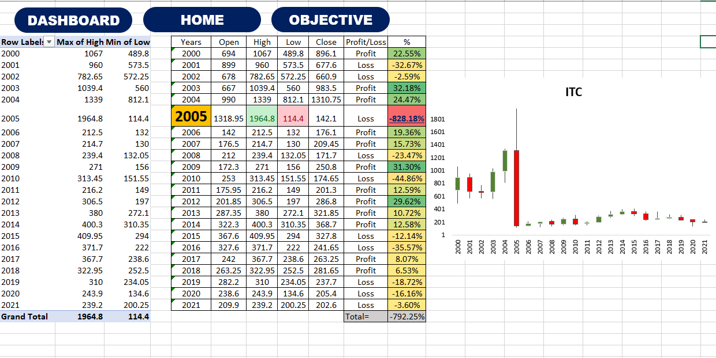
Analysis on dataset 1
The dataset 1 is of ITC company and we will analyse the data of ITC and try to find out in which year ITC had given huge loss

Slide 7
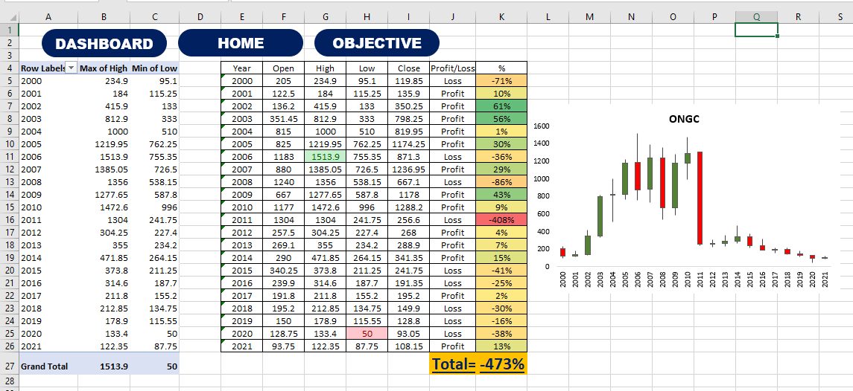
Analysis on dataset 2
The dataset 2 is of ONGC company and we will analyse the data of ONGC and try to find out total profit given by ONGC till now.

Slide 8
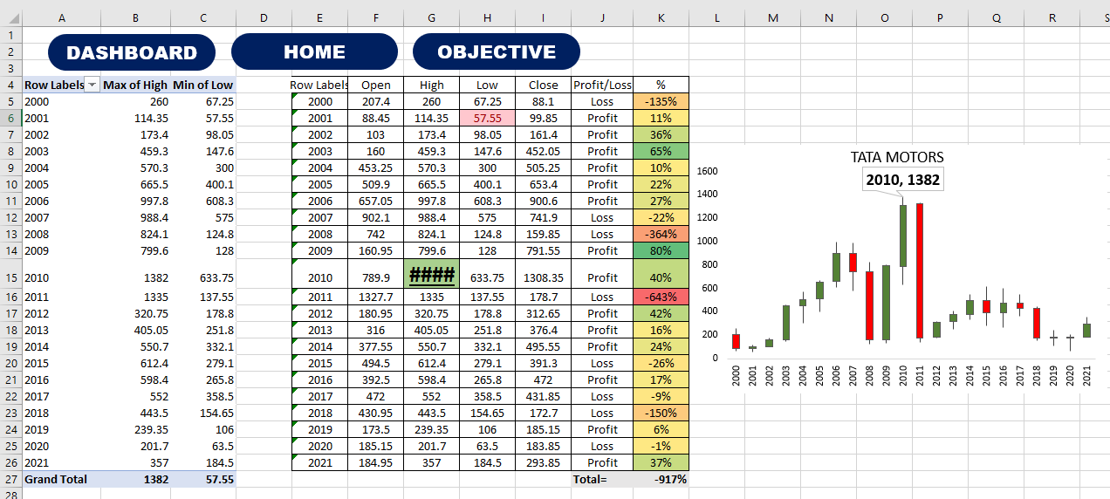
Analysis on dataset 3
The dataset 3 is of TATAMOTORS company and we will analyse the data of TATAMOTORS and try to find out its highest price till now and also create a stock chart.

Slide 9
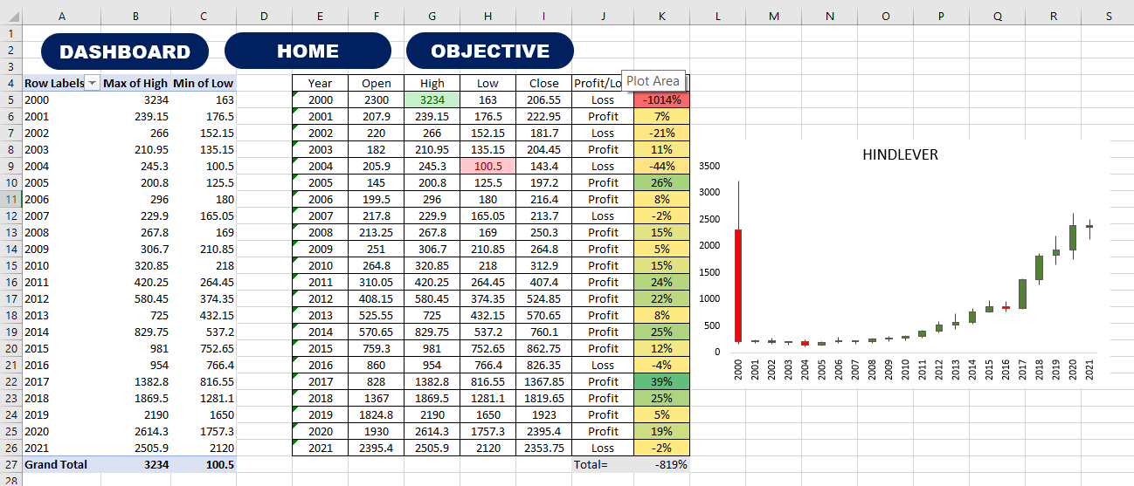
Analysis on dataset 4
The dataset 4 is of HINDUNILIVR company and we will analyse the data of HINDUNILIVR and will create a yearly stock chart using up&down bars

Slide 10
Analysis on dataset 5
The dataset 5 is of HDFC company and we will analyse the data of HDFC and try to find out in which year HDFC had its highest closing price

Slide 11
References
Kaggle
Youtube
Google
Books

